Slide 1
prediction of the effect of impeller trimming on centrifugal pump performance using AI.
Supervisor : prof. Mohamed farid Khalil
By :
mohammed twheed khater
Seif el eslam Ibrahim hassan

Slide 2
Project overview
This project aims to optimize and validate the performance of neural networks in predicting the characteristics of pump impeller trimming. The primary focus is on leveraging data-driven approaches to predict key metrics like flow rate, head, and power for different pump diameters. The project consists of several MATLAB scripts and data files, which together facilitate the preparation, training, and optimization of neural networks for this purpose.
Main topics
What is trimming in centrifugal pump impeller
Why trimming
Energy impact
Data Extraction or digitization
Neural networks
Genetic algorithm

Slide 3
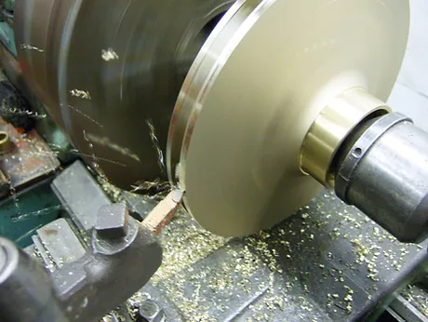
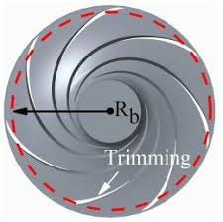
What is trimming in centrifugal pump impeller
It’s a process of impeller diameter reduction

Slide 4
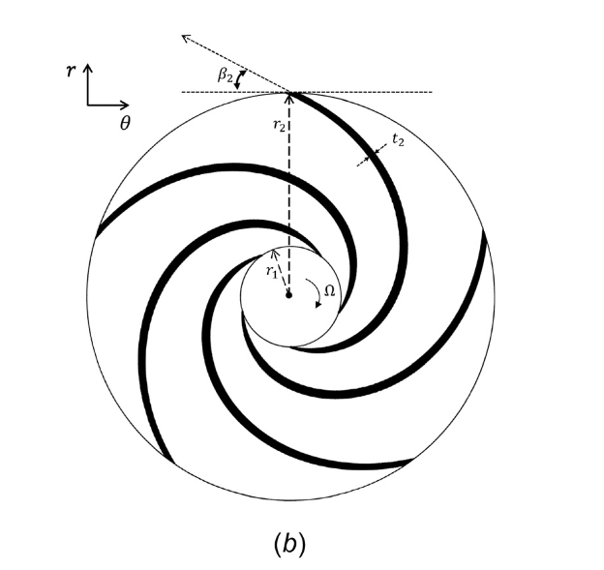
Trimming is not just limited to reducing the outer radius r2 but could also reduce the inner radius r1 but this is not considered here

Slide 5
Why Trimming
Performance Optimization:
  Adjusting pump capacity to meet specific system requirements.
  Reducing excess flow and pressure.
Energy Efficiency:
  Lowering power consumption.
  Reducing operational costs.
Cost Savings:
  Extending the lifespan of the pump.
  Decreasing maintenance and repair costs.

Slide 6
When to Consider Impeller Trimming
System design changes.
Over-sizing of the pump.
Energy audit recommendations.

Slide 7
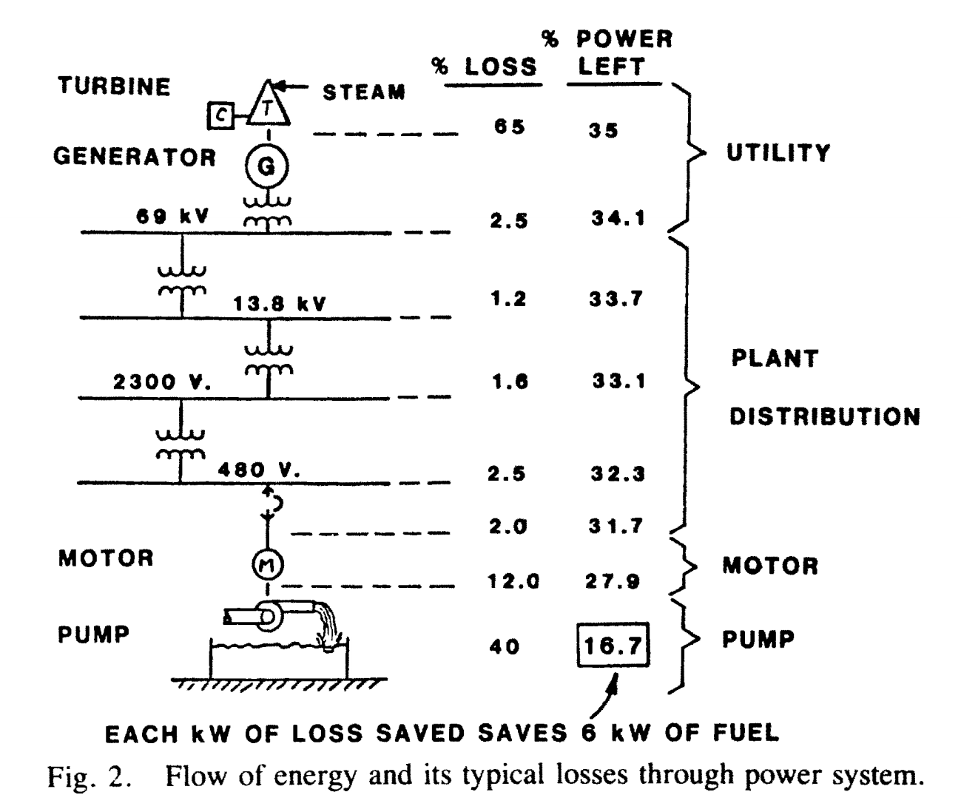
Fig. 2 gives us a picture of the flow of energy through a power system starting from fuel energy input into, say, a boiler down to actual work done by utilization equipment. Obviously, the big losses to be saved are thermal losses at the front end of the energy system, and this is the reason so much attention is being paid to combined cycle and cogeneration power plants. If we put 100 kW of fuel energy into the system, note that we normally get only 15-20 kW of useful work out at the utilization end. We might wonder why we should spend much effort on motors and their driven equipment when the large losses are at the front end. The answer comes quickly, however, when it is realized that, for every kilowatt of loss saved in the electrical utilization equipment or process drives, 6kW of fuel energy has been saved on the front end of the system. This point brings into sharper focus the need to find and save losses in process drives.

Slide 8
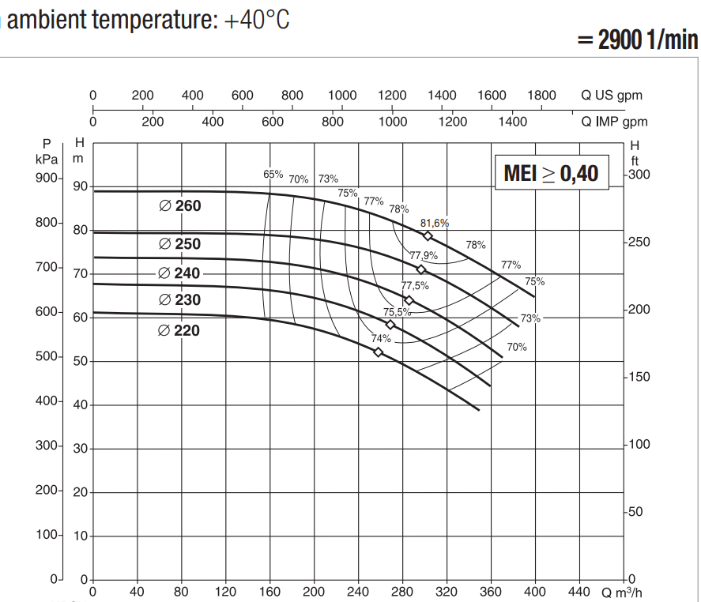


Q-H pump curves for different diameters according to literature the manufacturer only manufacture the largest diameter , then trim it to get the lower diameters (this much cheaper and efficient)

Slide 9
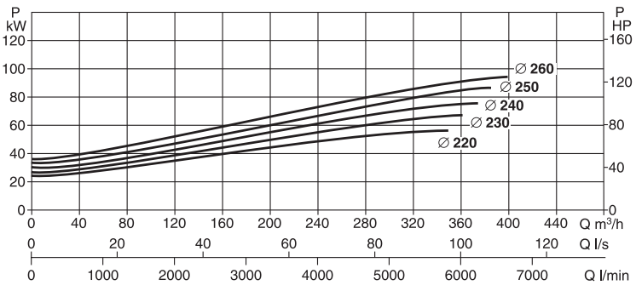
Q-P Curves

Slide 10
Digitization of Manufacturer Curves
Extract data from catalogue to computable dataset in csv format to be imported then in MATLAB.
Using a MATLAB tool found freely online called garbit
Or using WebPlotDigitizer (could be used online or downloaded locally it has more features than grabit).

Slide 11
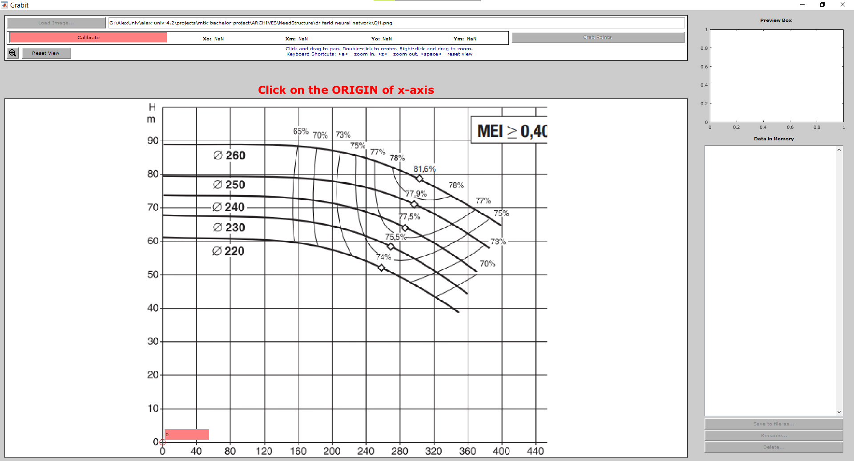
grabit

Slide 12
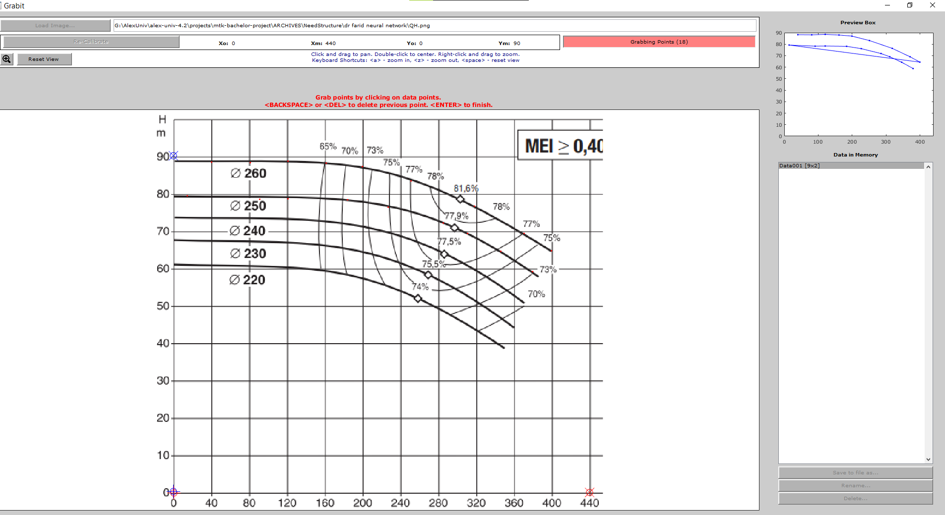

Slide 13
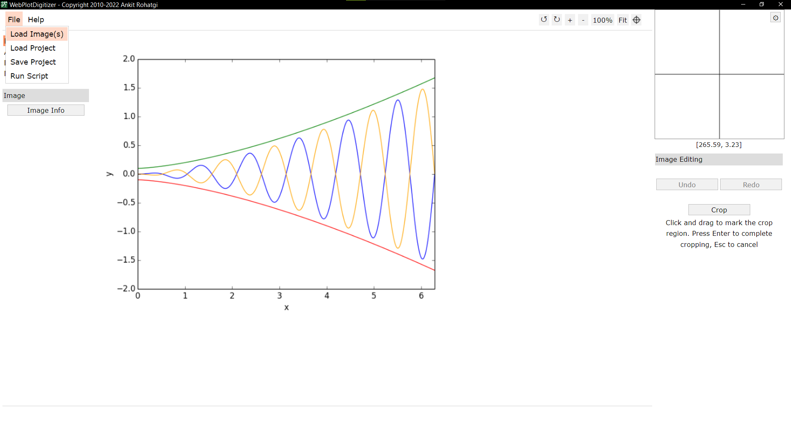
WebPlotDigitizer

Slide 14
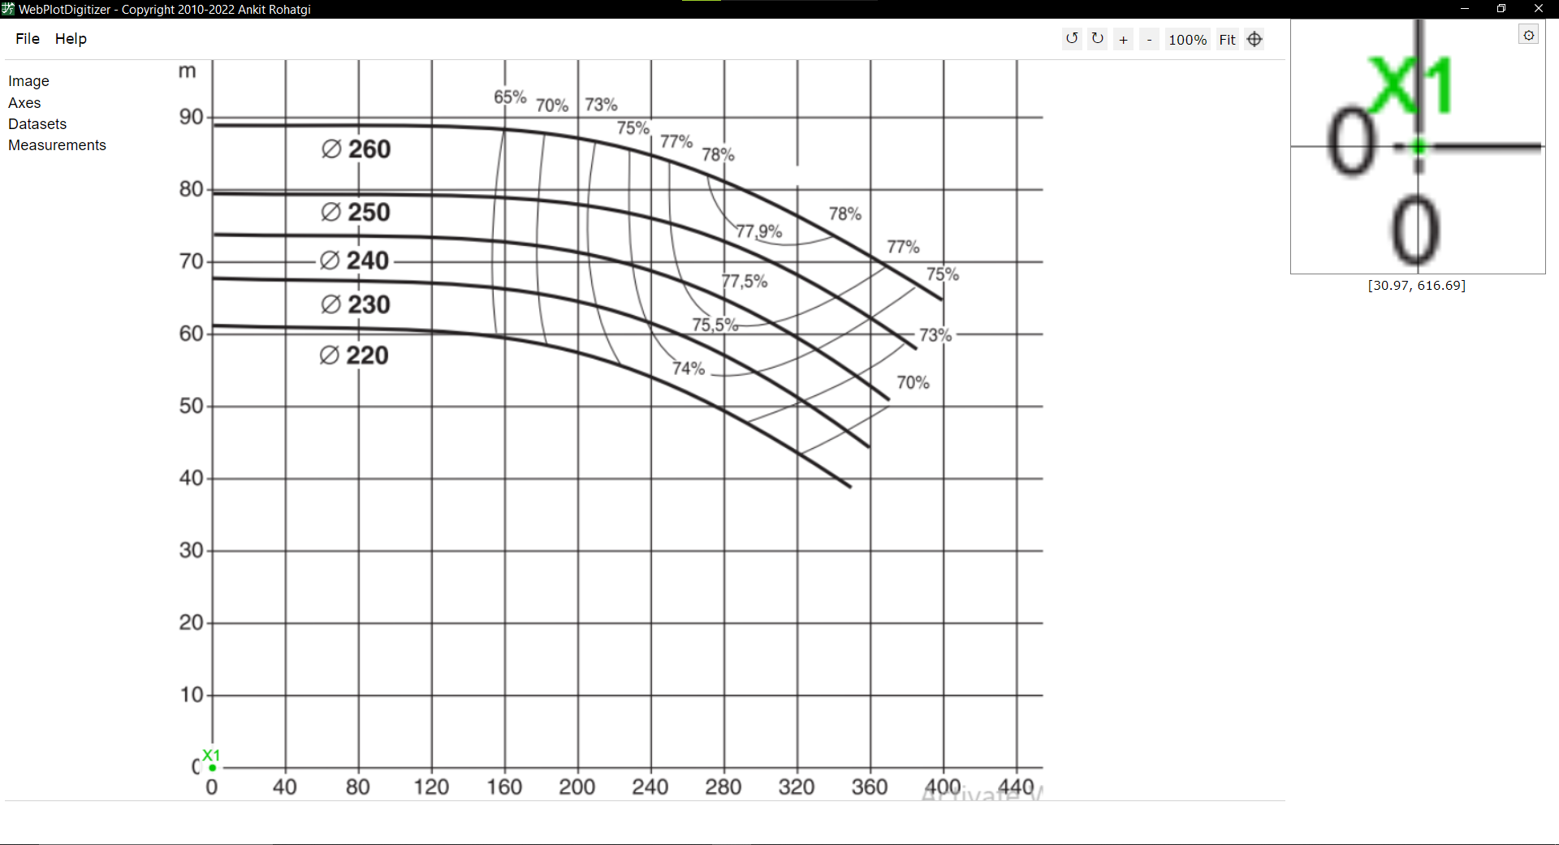
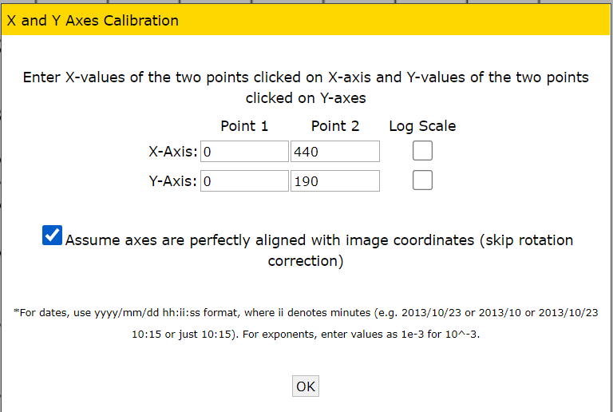

Slide 15
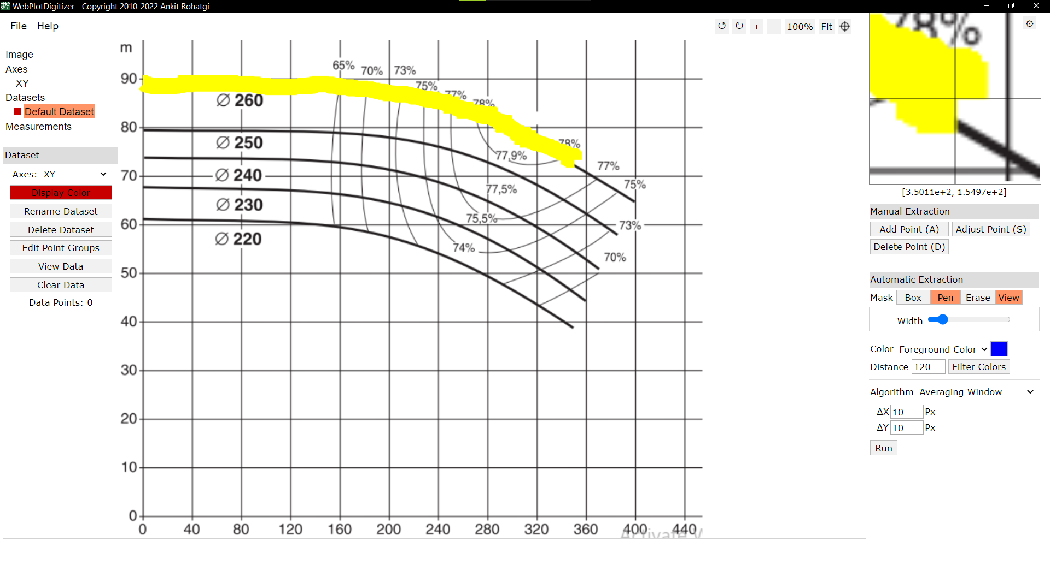

Slide 16
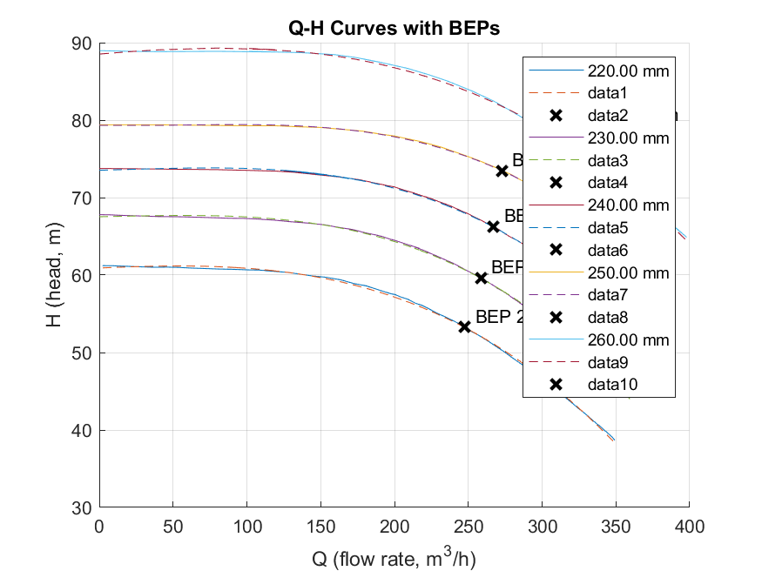
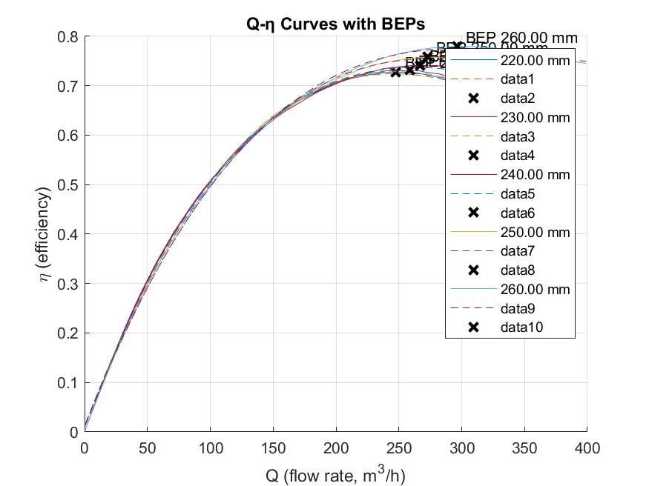
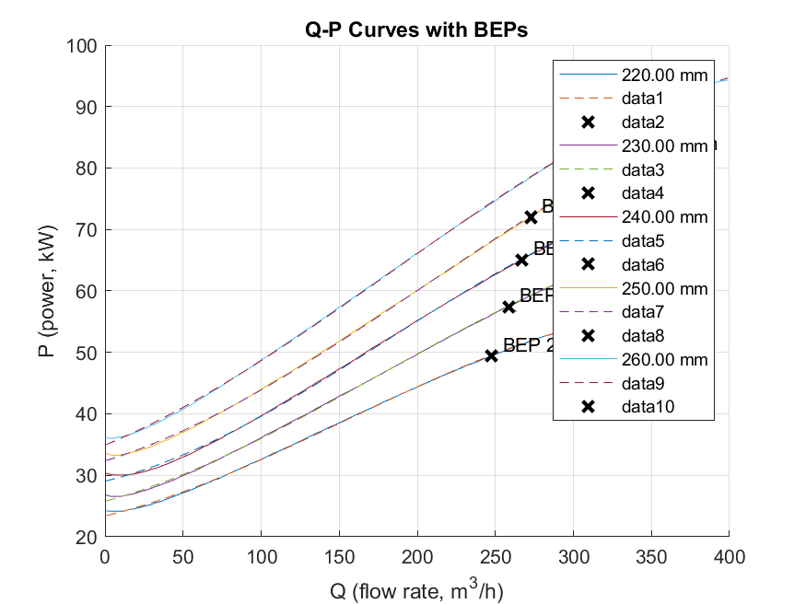
After data extraction here is a plot of it that fitted using MATLAB

Slide 17
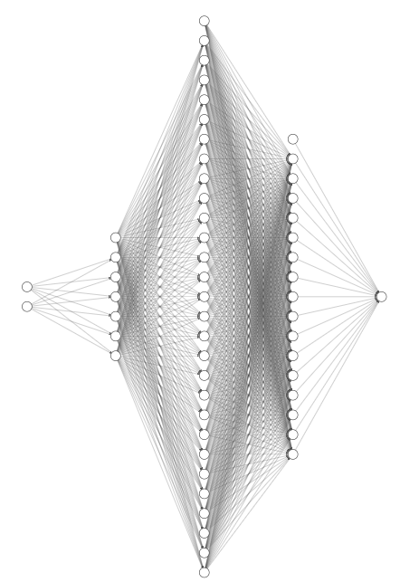





(Q-D) -> P , NN architecture this our optimum found NN for calculating Power from Q and D

Slide 18
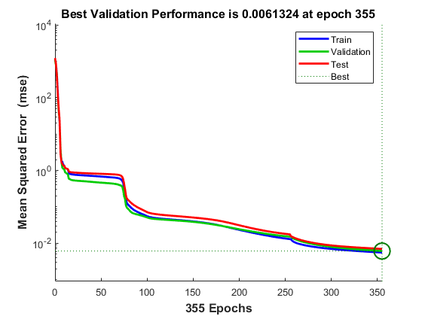
(Q-D) -> P , NN performance

Slide 20
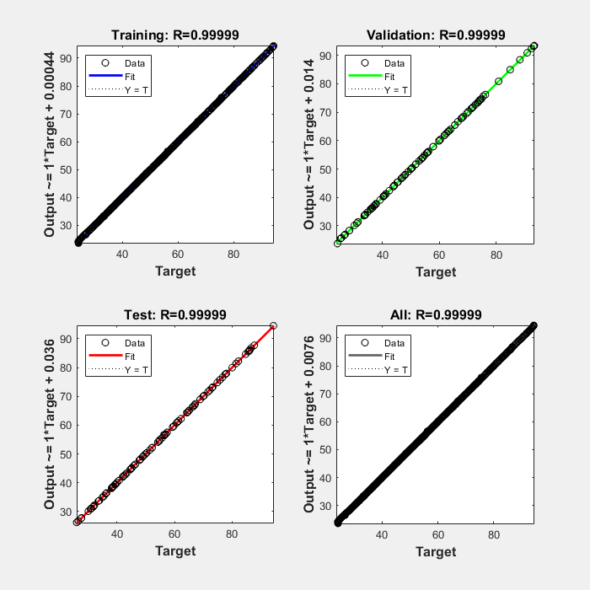
(Q-D) -> P , NN Regression

Slide 21
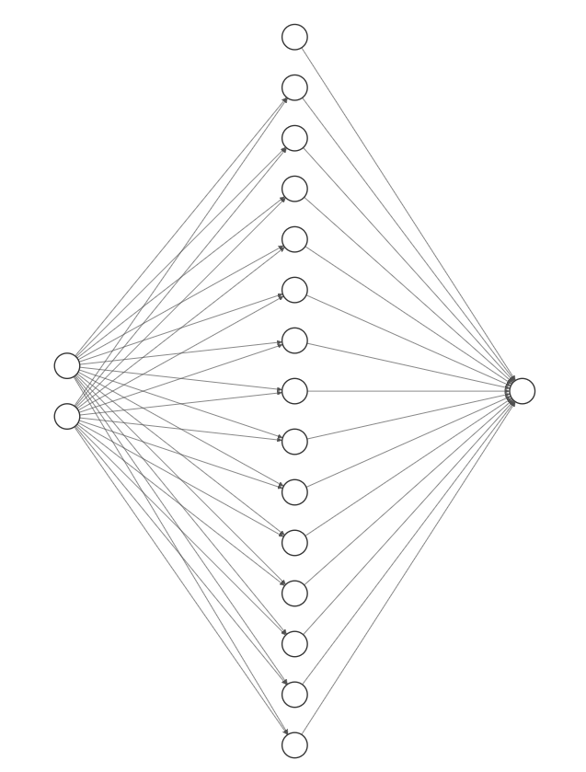



(Q-H) -> D , NN architecture this our optimum found NN for calculating Trimmed Diameter from Q and H

Slide 22
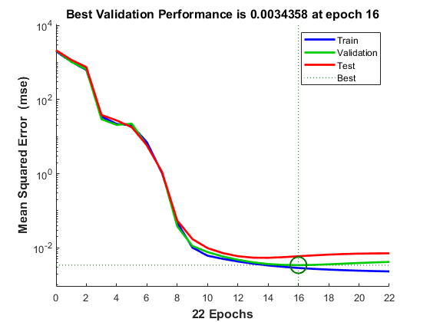
(Q,H)->D ,NN Performance

Slide 23
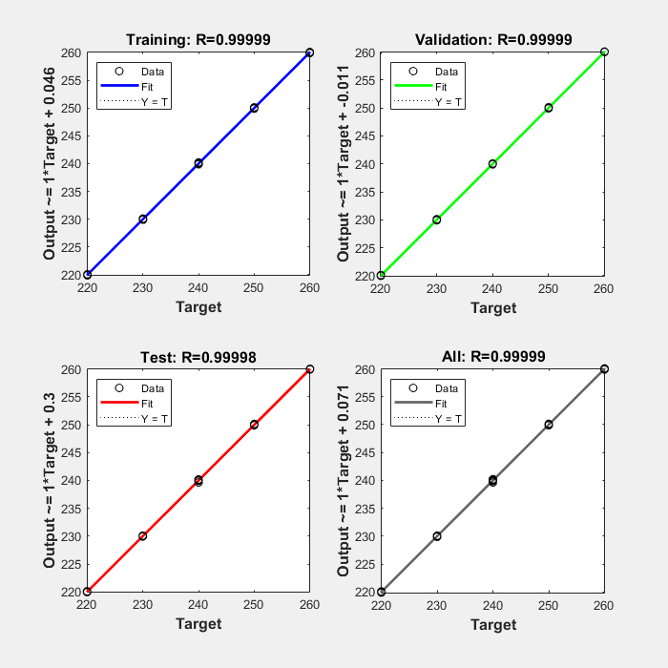
(Q-H) -> D , NN Regression

Slide 24
What and how Genetic algorithm
https://www.neuraldesigner.com/blog/genetic_algorithms_for_feature_selection/

Slide 25
What and How neural network works

